Slide 1

Logistic Regression
Nina Gunnes
December 3, 2020

Slide 2
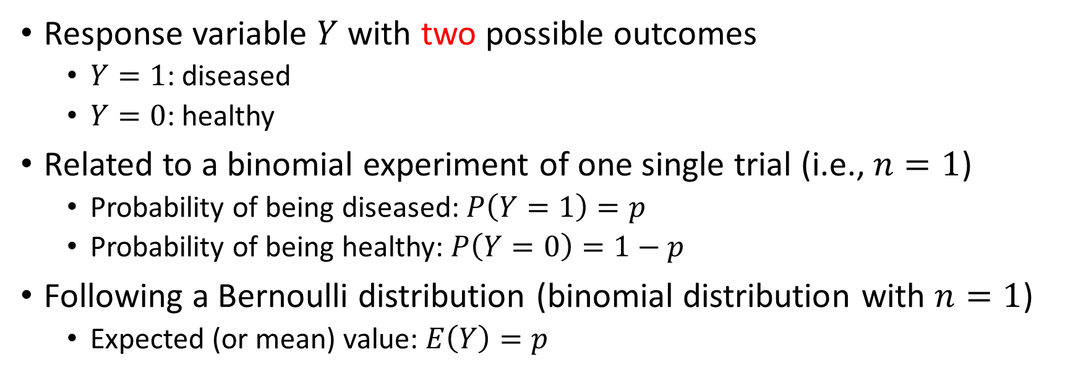
Dichotomous response variable
Response variable $Y$ with two possible outcomes
  $Y=1$: diseased
  $Y=0$: healthy
Related to a binomial experiment of one single trial (i.e., $n=1$)
  Probability of being diseased: $P\left(Y=1\right)=p$
  Probability of being healthy: $P\left(Y=0\right)=1−p$
Following a Bernoulli distribution (binomial distribution with $n=1$)
  Expected (or mean) value: $E\left(Y\right)=p$

Slide 3
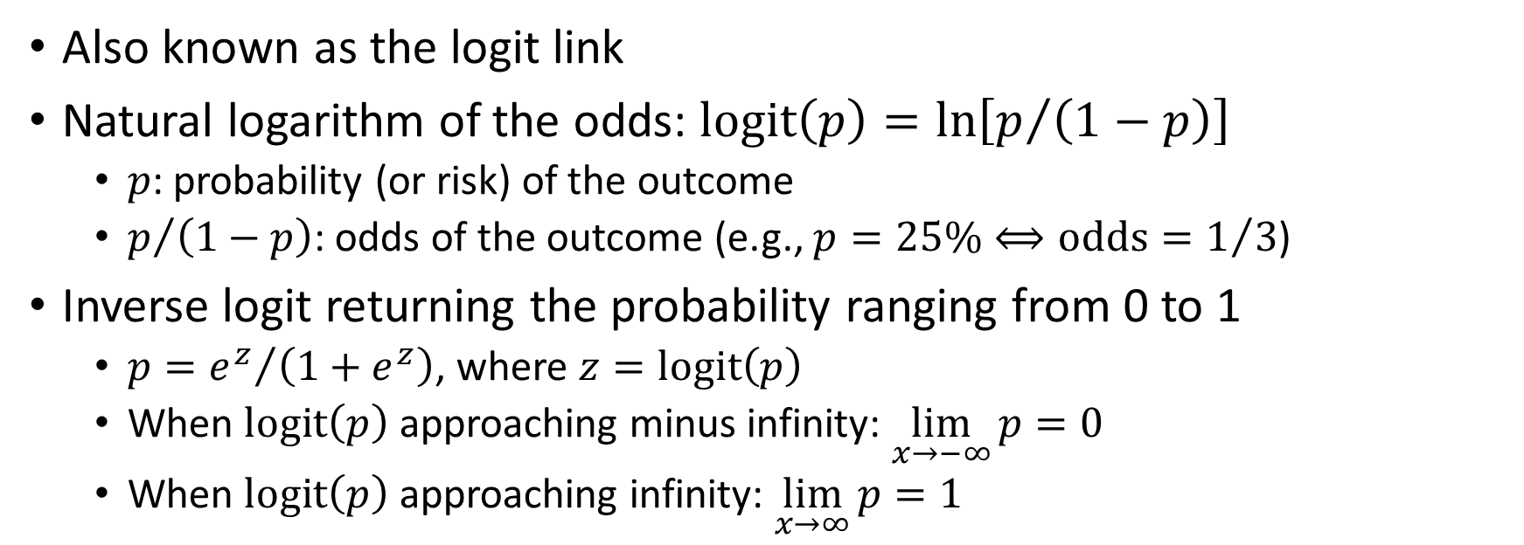
Logit transformation
Also known as the logit link
Natural logarithm of the odds: $\text{logit}\left(p\right)=\ln\left[p/{\left(1−p\right)}\right]$
  $p$: probability (or risk) of the outcome
  $p/{\left(1−p\right)}$: odds of the outcome (e.g., $p=25\%⟺\text{odds}=1/3$)
Inverse logit returning the probability ranging from 0 to 1
  $p={e^{z}}/{\left(1+e^{z}\right)}$, where $z=\text{logit}\left(p\right)$
  When $\text{logit}\left(p\right)$ approaching minus infinity: $\lim_{x→−∞}{p}=0$
  When $\text{logit}\left(p\right)$ approaching infinity: $\lim_{x→∞}{p}=1$

Slide 4
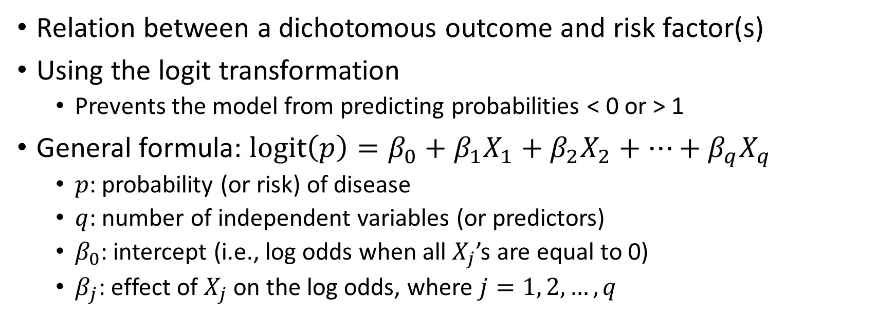
Logistic regression model
Relation between a dichotomous outcome and risk factor(s)
Using the logit transformation
  Prevents the model from predicting probabilities < 0 or > 1
General formula: $\text{logit}\left(p\right)=β_{0}+β_{1}X_{1}+β_{2}X_{2}+…+β_{q}X_{q}$
  $p$: probability (or risk) of disease
  $q$: number of independent variables (or predictors)
  $β_{0}$: intercept (i.e., log odds when all $X_{j}$’s are equal to 0)
  $β_{j}$: effect of $X_{j}$ on the log odds, where $j=1, 2,…,q$

Slide 5
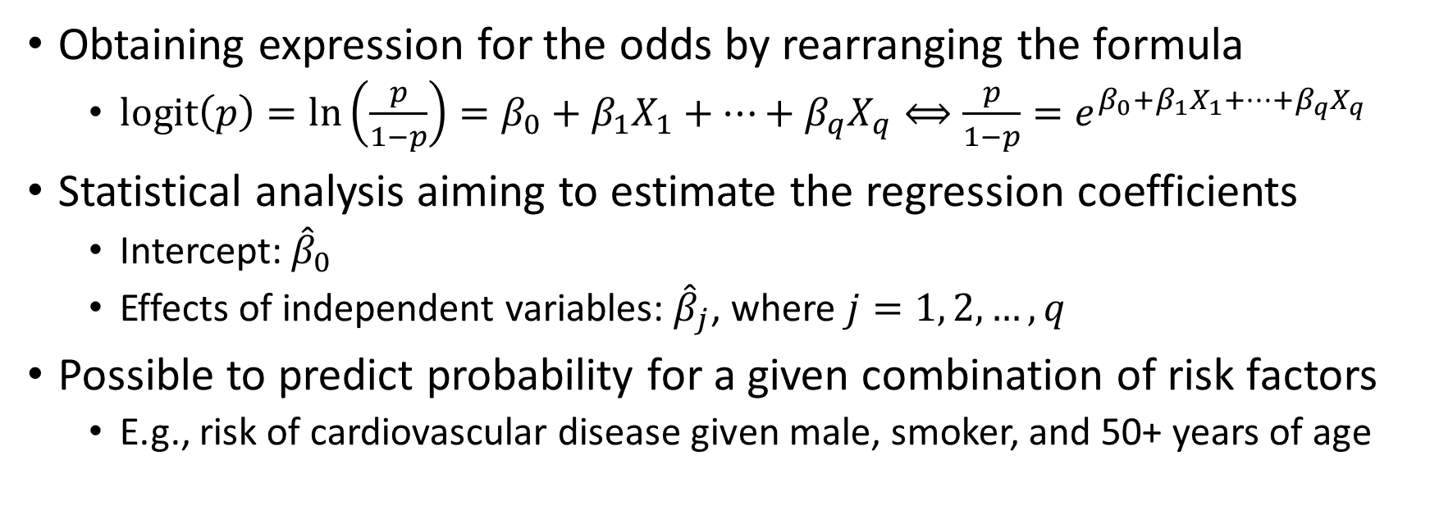
Logistic regression model, cont.
Obtaining expression for the odds by rearranging the formula
  $\text{logit}\left(p\right)=\ln\left(\frac{p}{1−p}\right)=β_{0}+β_{1}X_{1}+…+β_{q}X_{q}⟺\frac{p}{1−p}=e^{β_{0}+β_{1}X_{1}+…+β_{q}X_{q}}$
Statistical analysis aiming to estimate the regression coefficients
  Intercept: ${\hat{β}}_{0}$
  Effects of independent variables: ${\hat{β}}_{j}$, where $j=1, 2,…,q$
Possible to predict probability for a given combination of risk factors
  E.g., risk of cardiovascular disease given male, smoker, and 50+ years of age

Slide 6
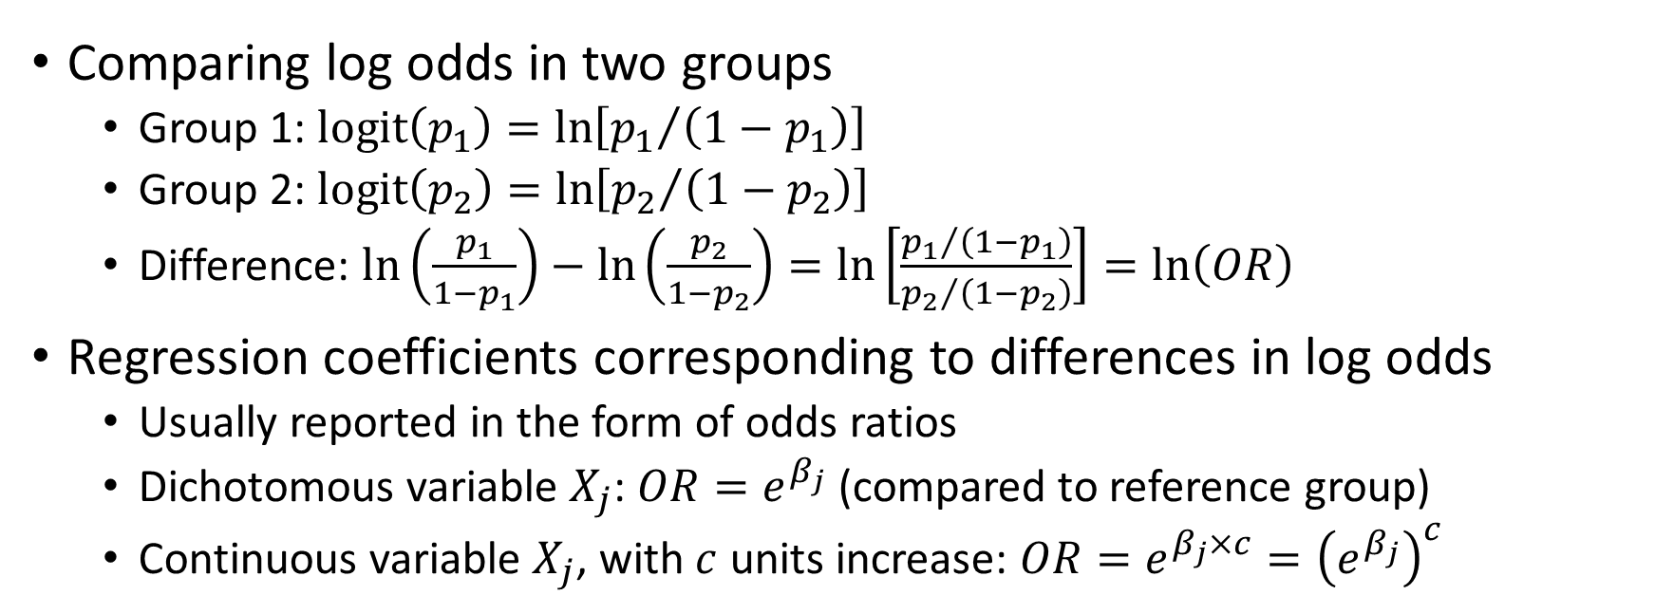
Effect measure
Comparing log odds in two groups
  Group 1: $\text{logit}\left(p_{1}\right)=\ln\left[{p_{1}}/{\left(1−p_{1}\right)}\right]$
  Group 2: $\text{logit}\left(p_{2}\right)=\ln\left[{p_{2}}/{\left(1−p_{2}\right)}\right]$
  Difference: $\ln\left(\frac{p_{1}}{1−p_{1}}\right)−\ln\left(\frac{p_{2}}{1−p_{2}}\right)=\ln\left[\frac{{p_{1}}/{\left(1−p_{1}\right)}}{{p_{2}}/{\left(1−p_{2}\right)}}\right]=\ln\left(OR\right)$
Regression coefficients corresponding to differences in log odds
  Usually reported in the form of odds ratios
  Dichotomous variable $X_{j}$: $OR=e^{β_{j}}$ (compared to reference group)
  Continuous variable $X_{j}$, with $c$ units increase: $OR=e^{β_{j}×c}={\left(e^{β_{j}}\right)}^{c}$

Slide 7
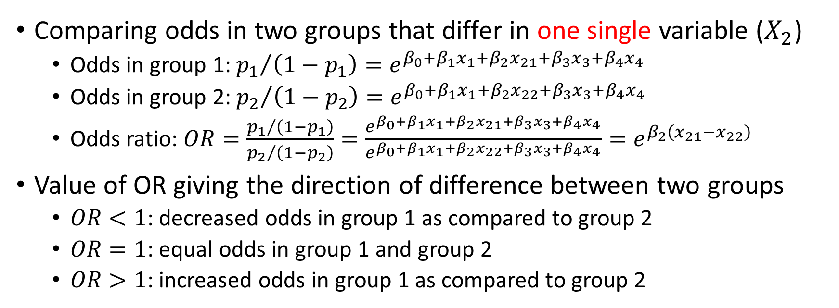
Effect measure, cont.
Comparing odds in two groups that differ in one single variable ($X_{2}$)
  Odds in group 1: ${p_{1}}/{\left(1−p_{1}\right)}=e^{β_{0}+β_{1}x_{1}+β_{2}x_{21}+β_{3}x_{3}+β_{4}x_{4}}$
  Odds in group 2: ${p_{2}}/{\left(1−p_{2}\right)}=e^{β_{0}+β_{1}x_{1}+β_{2}x_{22}+β_{3}x_{3}+β_{4}x_{4}}$
  Odds ratio: $OR=\frac{{p_{1}}/{\left(1−p_{1}\right)}}{{p_{2}}/{\left(1−p_{2}\right)}}=\frac{e^{β_{0}+β_{1}x_{1}+β_{2}x_{21}+β_{3}x_{3}+β_{4}x_{4}}}{e^{β_{0}+β_{1}x_{1}+β_{2}x_{22}+β_{3}x_{3}+β_{4}x_{4}}}=e^{β_{2}\left(x_{21}−x_{22}\right)}$
Value of OR giving the direction of difference between two groups
  $OR<1$: decreased odds in group 1 as compared to group 2
  $OR=1$: equal odds in group 1 and group 2
  $OR>1$: increased odds in group 1 as compared to group 2

Slide 8
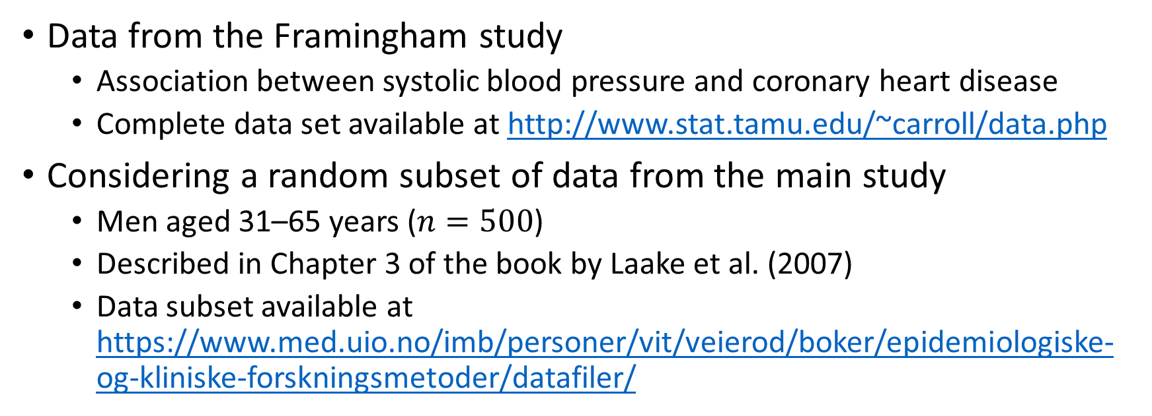
Example: Coronary heart disease
Data from the Framingham study
  Association between systolic blood pressure and coronary heart disease
  Complete data set available at http://www.stat.tamu.edu/~carroll/data.php
Considering a random subset of data from the main study
  Men aged 31–65 years ($n=500$)
  Described in Chapter 3 of the book by Laake et al. (2007)
  Data subset available at https://www.med.uio.no/imb/personer/vit/veierod/boker/epidemiologiske-og-kliniske-forskningsmetoder/datafiler/

Slide 9
Example: Coronary heart disease, cont.
One response variable
  firstchd: coronary heart disease (0 – no, 1 – yes)
Four explanatory variables
  smoke: smoking (0 – no, 1 – yes)
  meansbp: mean systolic blood pressure (mmHg)
  cholesterol: serum cholesterol (mg/dl)
  age: age (years)

Slide 10
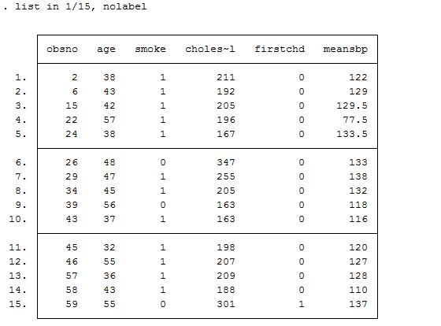
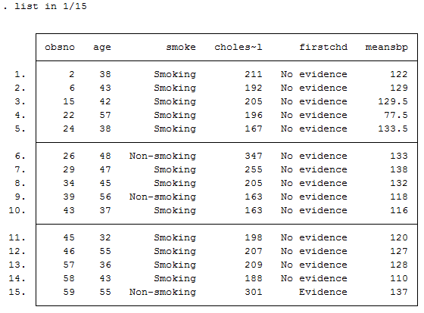
Example: Coronary heart disease, cont.

Slide 11
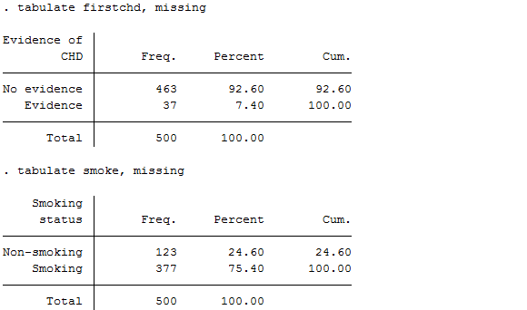
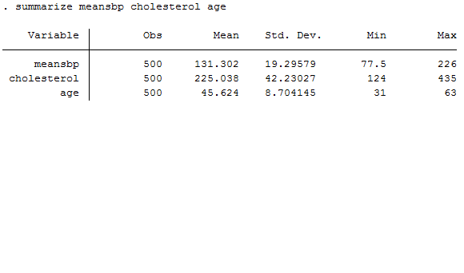
Example: Coronary heart disease, cont.

Slide 12
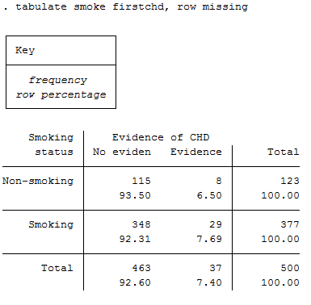
Example: Coronary heart disease, cont.

Slide 13
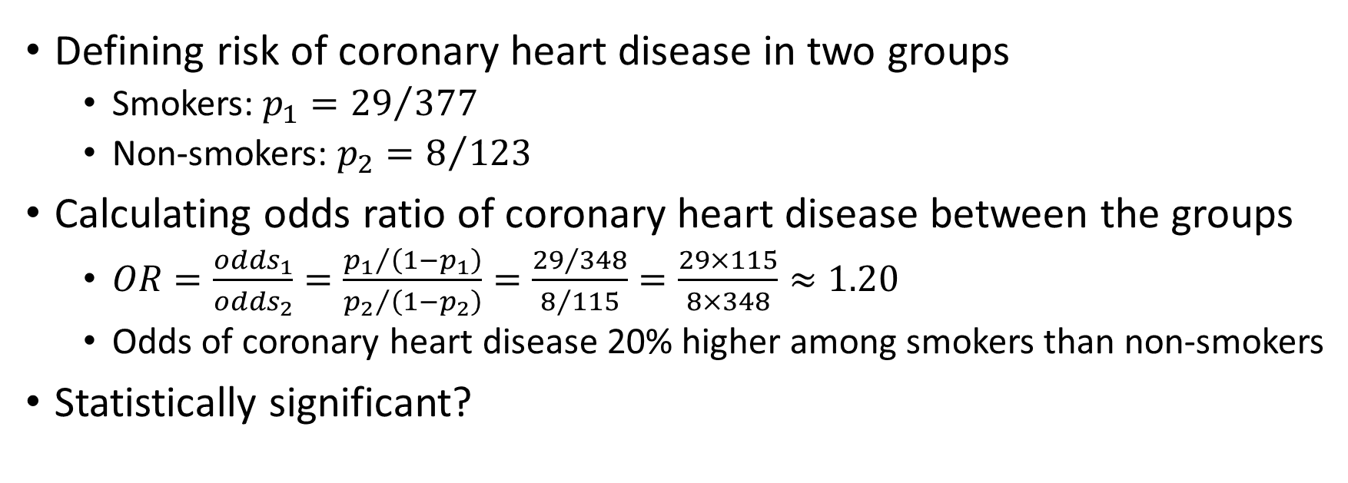
Example: Coronary heart disease, cont.
Defining risk of coronary heart disease in two groups
  Smokers: $p_{1}={29}/{377}$
  Non-smokers: $p_{2}=8/{123}$
Calculating odds ratio of coronary heart disease between the groups
  $OR=\frac{{odds}_{1}}{{odds}_{2}}=\frac{{p_{1}}/{\left(1−p_{1}\right)}}{{p_{2}}/{\left(1−p_{2}\right)}}=\frac{{29}/{348}}{8/{115}}=\frac{29×115}{8×348}≈1.20$
  Odds of coronary heart disease 20% higher among smokers than non-smokers
Statistically significant?

Slide 14
Logistic regression in Stata
Two available commands in Stata
  logit: reporting coefficients as default (odds ratios also possible!)
  logistic: reporting odds ratios as default (coefficients also possible!)
More information given in Stata’s documentation
  help logit
  help logistic
  “Many users prefer the logistic command to logit. Results are the same regardless of which you use – both are the maximum-likelihood estimator.”

Slide 15
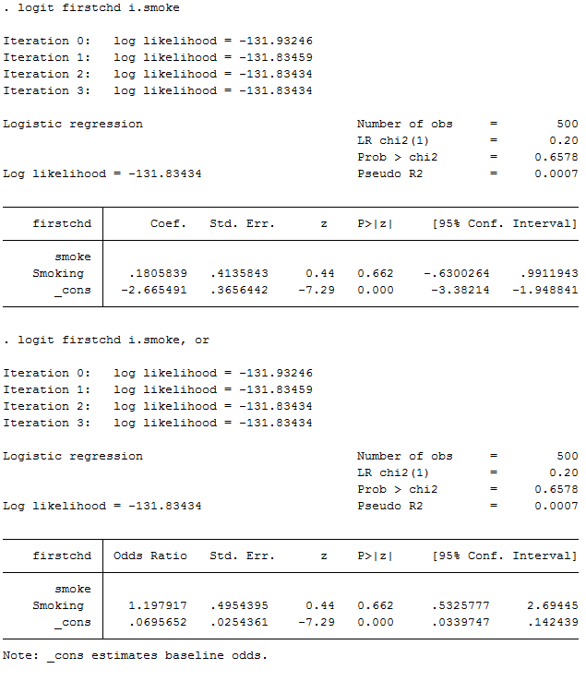
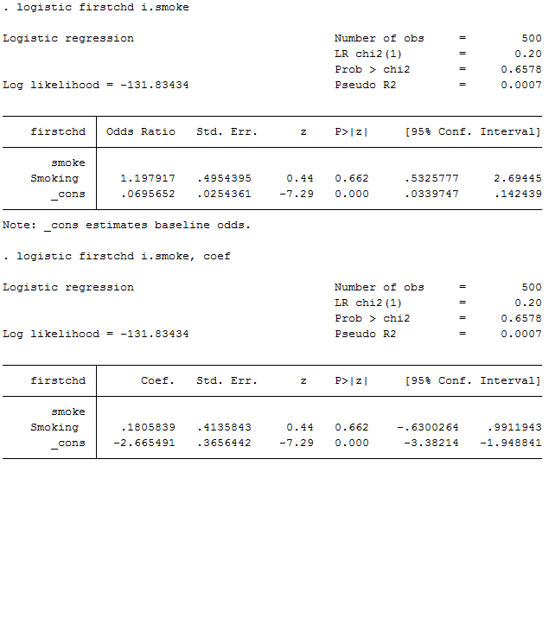
Example: Coronary heart disease, cont.

Slide 16
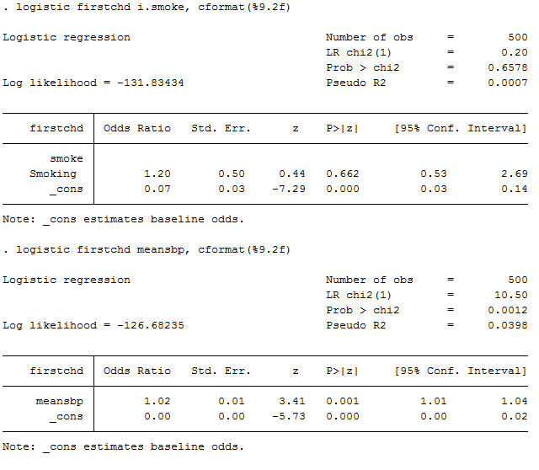
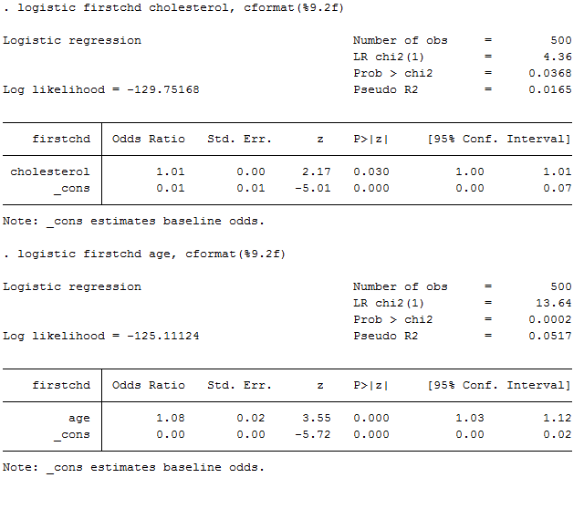
Example: Coronary heart disease, cont.

Slide 17
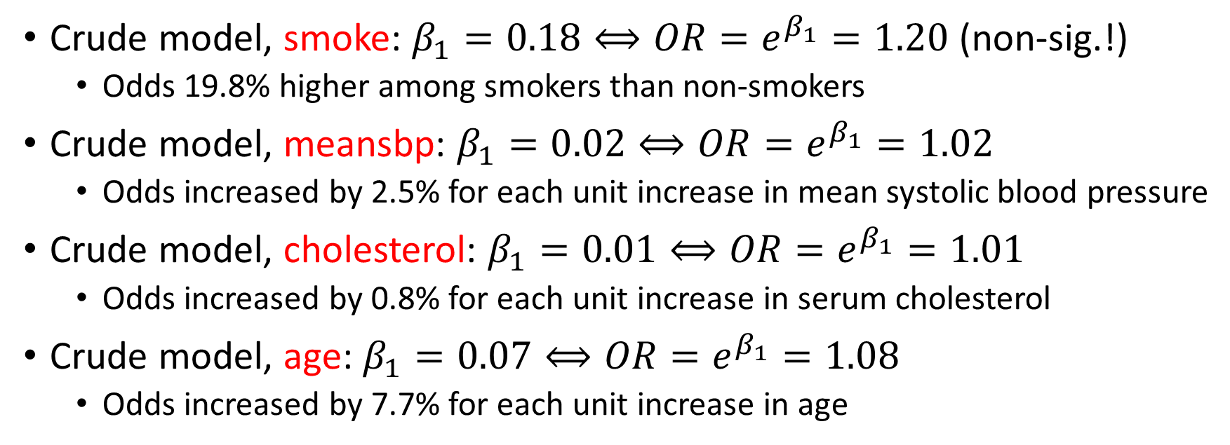
Example: Coronary heart disease, cont.
Crude model, smoke: $β_{1}=0.18⟺OR=e^{β_{1}}=1.20$ (non-sig.!)
  Odds 19.8% higher among smokers than non-smokers
Crude model, meansbp: $β_{1}=0.02⟺OR=e^{β_{1}}=1.02$
  Odds increased by 2.5% for each unit increase in mean systolic blood pressure
Crude model, cholesterol: $β_{1}=0.01⟺OR=e^{β_{1}}=1.01$
  Odds increased by 0.8% for each unit increase in serum cholesterol
Crude model, age: $β_{1}=0.07⟺OR=e^{β_{1}}=1.08$
  Odds increased by 7.7% for each unit increase in age

Slide 18
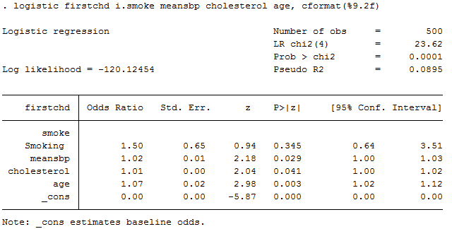
Example: Coronary heart disease, cont.

Slide 19
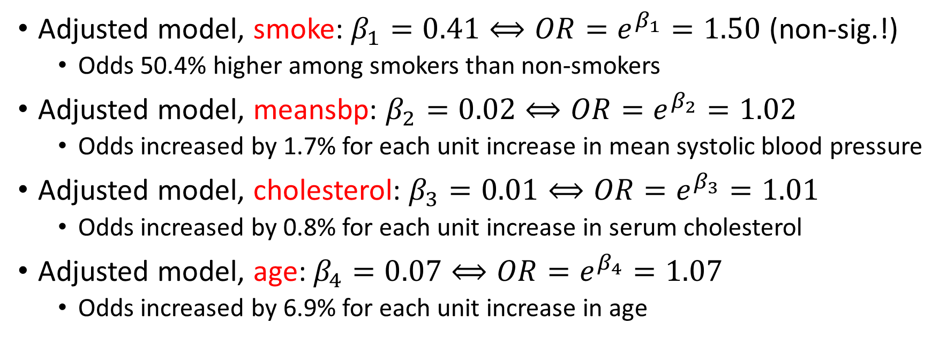
Example: Coronary heart disease, cont.
Adjusted model, smoke: $β_{1}=0.41⟺OR=e^{β_{1}}=1.50$ (non-sig.!)
  Odds 50.4% higher among smokers than non-smokers
Adjusted model, meansbp: $β_{2}=0.02⟺OR=e^{β_{2}}=1.02$
  Odds increased by 1.7% for each unit increase in mean systolic blood pressure
Adjusted model, cholesterol: $β_{3}=0.01⟺OR=e^{β_{3}}=1.01$
  Odds increased by 0.8% for each unit increase in serum cholesterol
Adjusted model, age: $β_{4}=0.07⟺OR=e^{β_{4}}=1.07$
  Odds increased by 6.9% for each unit increase in age

Slide 20
References
Aalen OO, Frigessi A, Moger TA, Scheel I, Skovlund E, Veierød MB. Statistiske metoder i medisin og helsefag. Oslo: Gyldendal akademisk; 2006.
Laake P, Hjartåker A, Thelle DS, Veierød MB. Epidemiologiske og kliniske forskningsmetoder. Oslo: Gyldendal akademisk; 2007. https://www.med.uio.no/imb/forskning/publikasjoner/boker/2007/epidemiolgiske-kliniske-forskningsmetoder.html.

